Slide 1


sorry
CONTENT UNDER DEVELOPMENT…

Slide 2
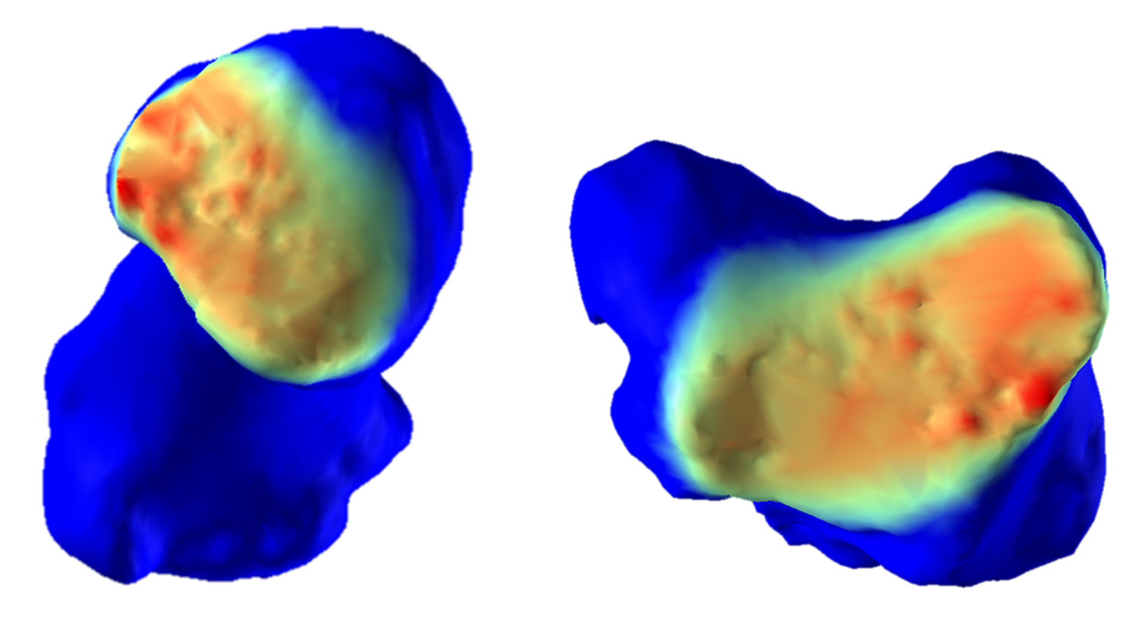
EVALUATING INTRA-ARTICULAR JOINT PRESSURE USING MEDICAL IMAGING TECHNOLOGY
PURPOSE
Understand pressure distribution patterns within human joint to better predict and prevent the occurrence of degenerative disorders (e.g. osteoathritis).
HOW
Develop an algorithm that models patient-specific cartilage morphologies from CT images collected during different tasks and maps the corresponding pressure distribution.
FINDINGS
Recurrent pressure distribution patterns observed that are associated with the preliminary location of degenerative changes.
© Copyright DOURTHE TECHNOLOGIES 2016

Slide 3
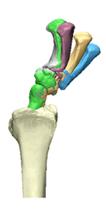
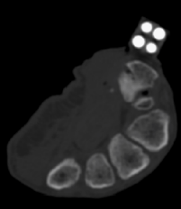
MEASURING THE ACCURACY OF DYNAMIC MEDICAL IMAGING TO ASSESS THUMB MOTION
PURPOSE
Apply dynamic medical imaging to overcome the limitations of current motion capture technologies regarding the quantification of mobility for small joints.
Dynamic thumb tracking
HOW
Collect and process dynamic CT images while controlled motion is applied to cadaveric samples embedded with silicon nitride beads.
FINDINGS
Dynamic medical imaging technology can be used to visualize and quantify 3D thumb mobility, making it a valuable tool to assess small joints’ kinematics in vivo.
© Copyright DOURTHE TECHNOLOGIES 2016

Slide 4
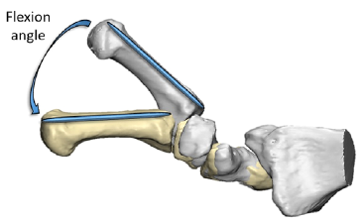
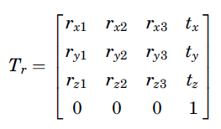
ASSESSING HUMAN JOINTS MOBILITY USING STATIC MEDICAL IMAGING TECHNOLOGY
PURPOSE
Develop a marker-free motion capture technique using medical imaging to assess and understand human joint mobility.
THUMB MOBILITY
HOW
Develop an algorithm that calculates 3D transformations between bone models generated via CT imaging reconstruction.
FINDINGS
The algorithm developed in this study offers new possibility to assess the mobility of small human joints, which would not be measurable via traditional motion capture.
© Copyright DOURTHE TECHNOLOGIES 2017

Slide 5
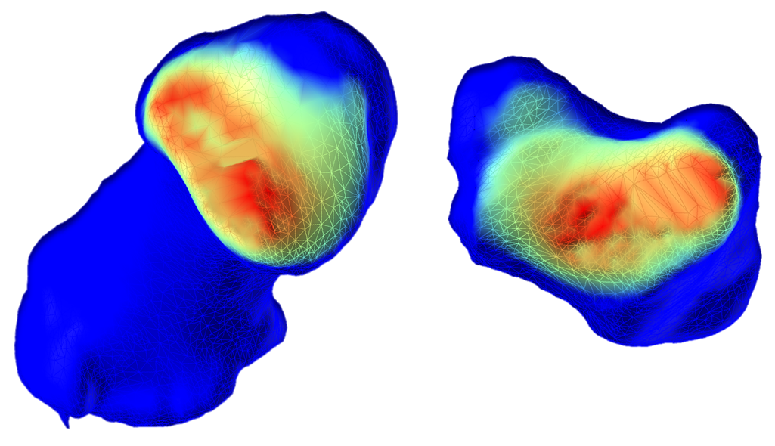
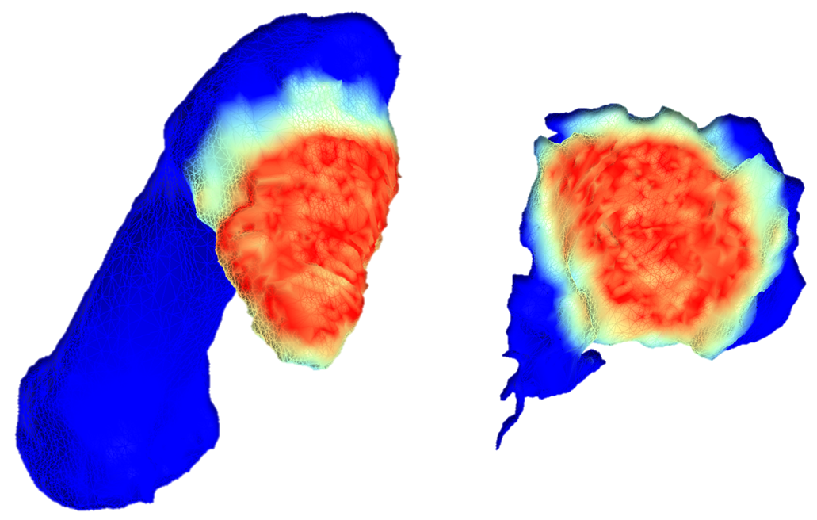
ASSESSING THE MORPHOLOGICAL IMPACT OF THUMB OSTEOARTHRITIS
PURPOSE
Better understand how degenerative joint diseases occurs by comparing pressure distribution patterns between healthy and osteoarthritic (OA) subjects.
HEALTHY
HOW
Design a proximity mapping algorithm to estimate and compare patient-specific intra-articular pressure distribution patterns from medical images.
OA
FINDINGS
This study improved our understanding of OA development by assessing how joint pressure is distributed during tasks of daily living for healthy and arthritic subject.
© Copyright DOURTHE TECHNOLOGIES 2017

Slide 6
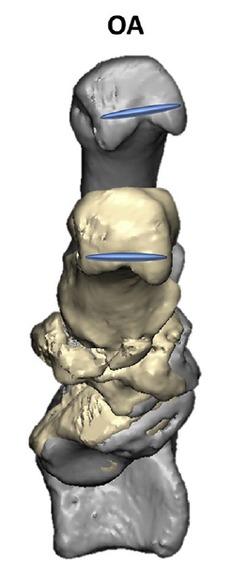
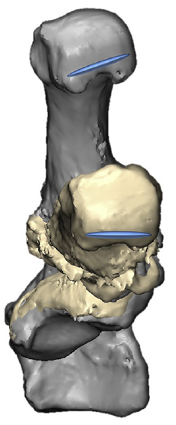
MEASURING THE IMPACT OF TOTAL THUMB REPLACEMENT ON HAND MOBILITY
PURPOSE
Understand how total thumb replacement prosthesis affect and/or restore the mobility of patients who suffered from advanced joint degeneration.
OA
HOW
Collect patient’s pre- and post-surgery CT scans while performing defined movements and quantify mobility using custom-made medical imaging-based motion capture algorithm.
IMPLANT
FINDINGS
Thumb arthroplasty partially restores joint function and mobility but cannot fully replicate the kinematics of the healthy thumb. Such results can potentially help enhance current implant designs.
© Copyright DOURTHE TECHNOLOGIES 2018

Slide 7
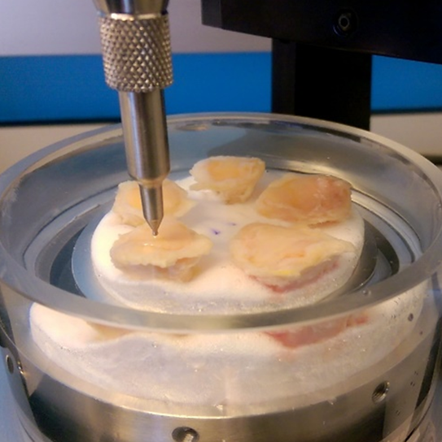
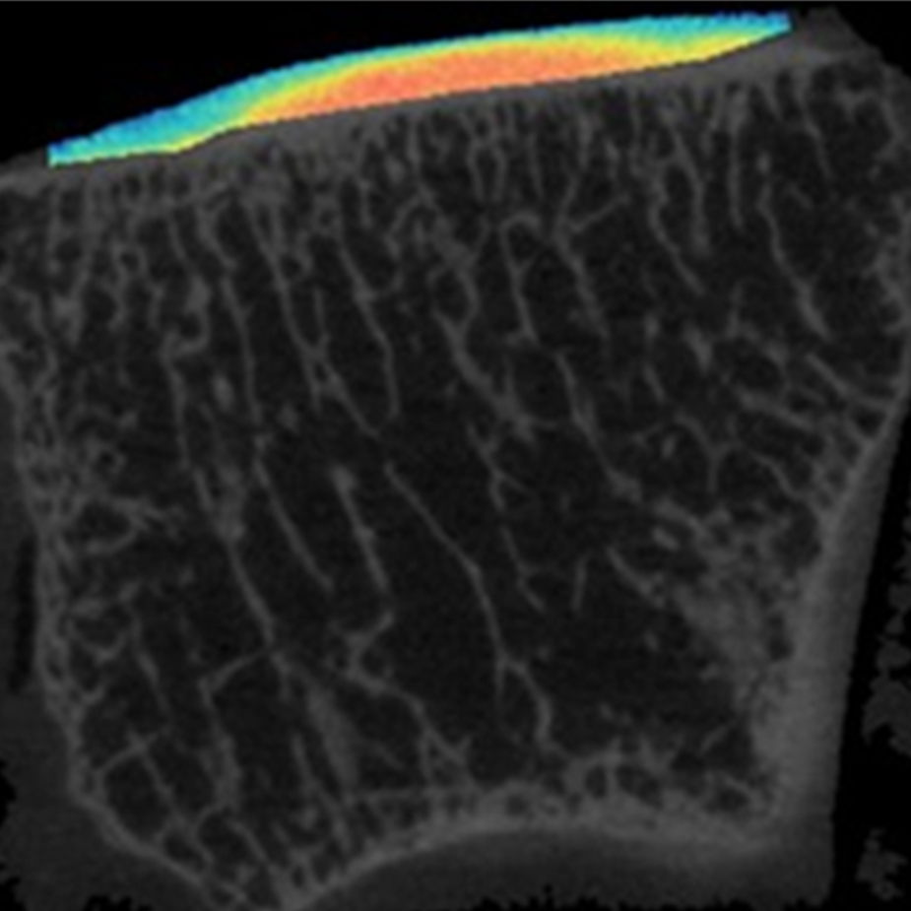
ASSESSING SOFT TISSUES PROPERTIES USING CONTRAST ENHANCED MEDICAL IMAGING
PURPOSE
Enable the patient-specific in vivo assessment of soft tissue morphology and mechanical properties using a non-destructive medical imaging-based approach.
HOW
Measure cartilage behavior using custom indentation technology and collect contrast-enhanced CT scans to assess the association between mechanical and image properties.
FINDINGS
This work provides a new method for the patient-specific assessment of cartilage properties, as well as a dataset for the development of more accurate computer models of human joints.
© Copyright DOURTHE TECHNOLOGIES 2019

Slide 8
DEVELOPMENT OF A
3D TRANSFORMATIONS TOOLBOX
DESCRIPTION
This toolbox contains custom Python codes enabling essential 3D operations for applications in the fields of Motion Capture and 3D Image Processing.
CONTENT
Global to local transformations | Calculates the rotation and translation matrices allowing the transformations of a data set from a global to a local coordinate system (and vice versa).
Motion capture processing | Use rigid body dynamics to extract the 3D trajectories of joint centers from static and dynamic marker-based motion capture data (e.g. Vicon).
Nearest (Euclidean) neighbor | Find the nearest (Euclidean) neighbor between two data sets of points.
Iterative Closest Point (ICP) | Use an ICP method to find the best-fit transform that maps solid A on to solid B (for 3D registration).
© Copyright DOURTHE TECHNOLOGIES 2019

Slide 9
DEVELOPMENT OF A
SIGNAL PROCESSING TOOLBOX
DESCRIPTION
This toolbox contains custom Matlab and Python codes enabling essential signal processing operations enabling the filtering, interpolation and analysis of time series (including biosignals).
CONTENT
Denoising | Moving average, Gaussian and Median filter, Detrending, LSTM filter, TKEO and Z-scores.
Filtering and Spectral analysis | Linear-phase finite impulse response (FIR) filter, Welch method, Fast Fourier Transform (FFT).
Interpolation and Resampling | Cubic spline interpolation/resampling of time series, Data reshaping tool, NaN finder.
Signals comparison | Signals delay assessment (using FFT), Intraclass correlation (ICC) calculation, Dynamic time wrapping excursions between time series.
© Copyright DOURTHE TECHNOLOGIES 2019

Slide 10
MEASURING THE IMPACT OF COMPRESSION GARMENTS ON SHOULDER STABILITY
PARTNER
Per4ma Sports Technology LTD is a Canadian company that designs compression garments with the objective to improve athletic performance and promote post-injury recovery.
PURPOSE
Compare the Per4ma garments to a leading competitor and a control with respect to its effect on mobility and stability performances, posture, comfort and fatigue.
FINDINGS
The Per4ma shirt may contribute to an improved control of shoulder mobility, thereby limiting the risks of shoulder injuries.
Due to privacy restrictions, full disclosure of the study’s conclusions is not permitted
© Copyright DOURTHE TECHNOLOGIES 2019

Slide 11
COMPARISON BETWEEN FOOT PRESSURE MAPPING TECHNOLOGIES
PARTNER
Orpyx Medical Technologies Inc. is a Canadian company that designs foot pressure measurement technologies used to improve human health and advance sports performance.
PURPOSE
Compare the accuracy of the Orpyx LogR Gen 2 prototype to the well-established Pedar System and a Kistler force plate with respect to several biomechanical variables.
FINDINGS
Comparable center of pressure trajectories and ground reaction forces were found among the different tested systems.
Due to privacy restrictions, full disclosure of the study’s conclusions is not permitted
© Copyright DOURTHE TECHNOLOGIES 2019

Slide 12
MEASURING THE IMPACT OF CUSTOM ORTHOTICS ON LEGS AND FEET BIOMECHANICS
PARTNER
Dr. Scholl's® is a footwear and orthopedic foot care brand who recently introduced the concept of self-selected customized orthotics in the market.
PURPOSE
To quantify the impact of self-selected customized orthotics on the legs and feet during long periods of standing, as well as during regular and uphill power walking.
FINDINGS
The results of this study indicate some benefits regarding the use of self-selected customized orthotics with respect to lower limb biomechanics and perceived fatigue.
Due to privacy restrictions, full disclosure of the study’s conclusions is not permitted
© Copyright DOURTHE TECHNOLOGIES 2019

Slide 13
DEVELOPMENT OF AN IMAGE ANNOTATION TOOL FOR ALGORITHM PERFORMANCE ASSESSMENT
PARTNER
CURV Labs is a Canadian company that uses artificial intelligence to help assess, identify and manage musculoskeletal performance and problems.
PURPOSE
To build an image annotation algorithm to manually label landmarks on 2D video data for comparison with the results of CURV Labs’ machine learning algorithm outcome.
FINDINGS
Due to privacy restrictions, the disclosure of the study’s conclusions is not permitted.
© Copyright DOURTHE TECHNOLOGIES 2019

Slide 14
MOTION CAPTURE ENHANCEMENT USING SEQUENCE MODELING AND RECURRENT NEURAL NETWORK
BACKGROUND
Marker-less motion capture technologies are cheaper and more accessible than marker-based multi-camera systems. If their accuracy is deemed sufficient, they have the potential to become great clinical tools for orthopedics and injury risk assessment.
However, research has indicated that such technologies have limited accuracy when it comes to measuring complex movements that have narrower amplitudes.
OBJECTIVE
Train a Recurrent Neural Network to enhance the performance of the Microsoft Kinect 3D camera. More specifically, the model's aim is to learn the mapping from Kinect joint centers trajectories to Vicon* joint angles.
*multi-camera marker-based motion capture technology, considered here as Gold Standard
© Copyright DOURTHE TECHNOLOGIES 2019

Slide 15
REAL VS. FAKE NEWS CLASSIFICATION USING
NATURAL LANGUAGE PROCESSING
BACKGROUND
Since 2016, the term Fake News has been used a lot across many forms of Media. With easy access to publishing materials online, it became harder for most people to know whether a source of information should be considered Real or Fake News.
Ultimately, most News articles can be classified using science and fact-checking. But can we use Natural Language Processing and Machine Learning to find patterns to automatically differentiate Real from Fake News?
OBJECTIVE
Train a Naive Bayes Machine Learning model to detect distinguishing patterns between Real and Fake News.
© Copyright DOURTHE TECHNOLOGIES 2019

Slide 16
PREDICTING OCEAN WATER TEMPERATURE USING LINEAR REGRESSION
BACKGROUND
The California Cooperative Oceanic Fisheries Investigations (CalCOFI) are a unique partnership of the California Department of Fish & Wildlife, NOAA Fisheries Service and Scripps Institution of Oceanography.
Their focus is the study of the marine environment off the coast of California, the management of its living resources, and monitoring the indicators of El Nino and climate change.
OBJECTIVE
Train a Linear Regression model to predict the ocean water temperature based on different metrics from the California Cooperative Oceanic Fisheries Investigations (CalCOFI) Database.
© Copyright DOURTHE TECHNOLOGIES 2019

Slide 17
PREDICTING RISK OF CORONARY HEART DISEASE USING SUPPORT VECTOR MACHINE
BACKGROUND
The Framingham Heart Study (FHS) is an epidemiologic study begun in Framingham in 1948 with 5,209 men and women. Since that time the FHS has studied three generations of participants resulting in biological specimens and data from nearly 15,000 participants.
This clinically and genetically well-characterized population is a valuable scientific source that is maintained under the joint stewardship of Boston University and the NHLBI.
OBJECTIVE
Train a Support Vector Machine classifier to predict the risk of developing coronary heart disease within 10 years using data from the Framingham Heart Study.
Additional challenge: implement cross-validation and over-sampling techniques to deal with the imbalance of the dataset.
© Copyright DOURTHE TECHNOLOGIES 2019

Slide 18
DETECTING FRAUDULENT CREDIT CARD TRANSACTIONS USING LOGISTIC REGRESSION
BACKGROUND
The datasets contains transactions made by credit cards in September 2013 by European cardholders. The dataset is highly unbalanced, where the positive class (frauds) account for 0.172% of all transactions (close to 300,000 transactions total).
The dataset contains only numerical input variables that are the result of a Principal Component Analysis, where the original features remain confidential.
OBJECTIVE
Train a Logistic Regression model to identify fraudulent credit card transactions.
Additional challenge: implement cross-validation and over-sampling techniques to deal with the imbalance of the dataset.
© Copyright DOURTHE TECHNOLOGIES 2019

Slide 19
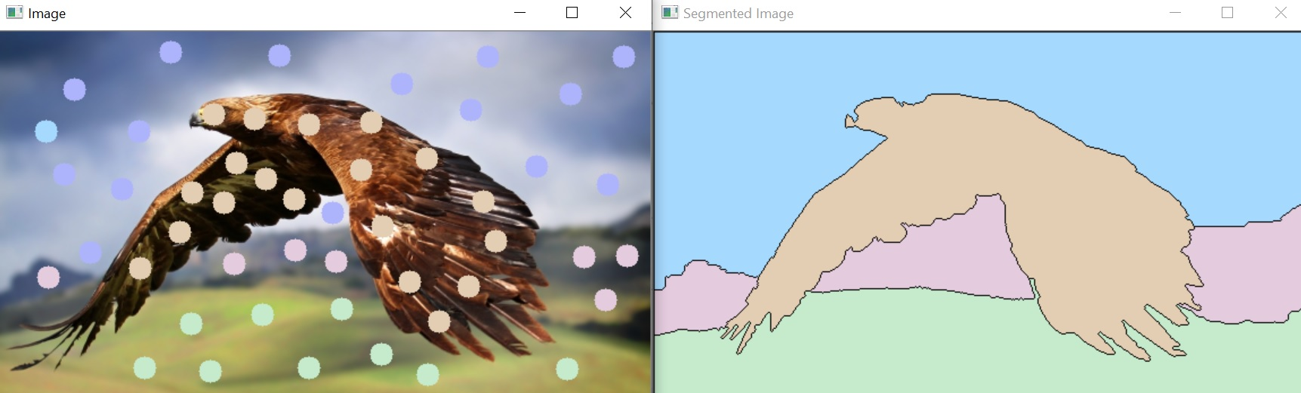
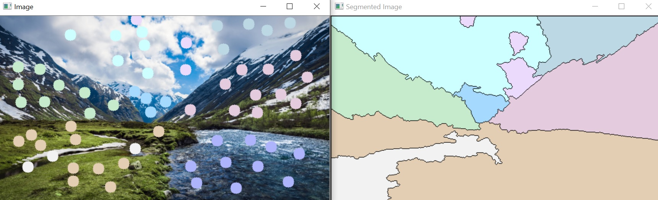
SEMI-AUTOMATED IMAGE SEGMENTATION USING THE WATERSHED ALGORITHM
OBJECTIVE
Build a function enabling the semi-automated segmentation of 2D images using the functionality of the Watershed Algorithm.
PREVIEW
In order to use the functionality of the Watershed algorithm, the user simply has to click on the display image to define the location of markers.
© Copyright DOURTHE TECHNOLOGIES 2019

Slide 20
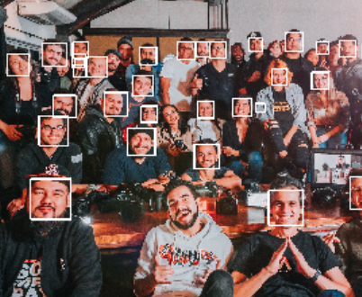
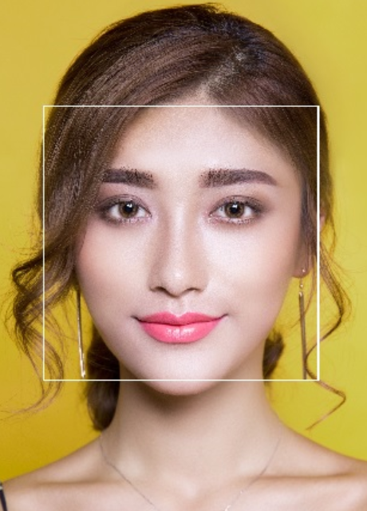
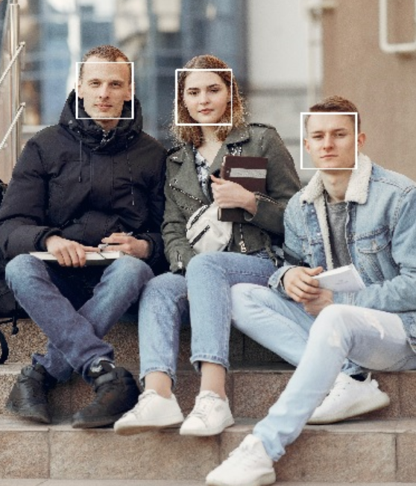
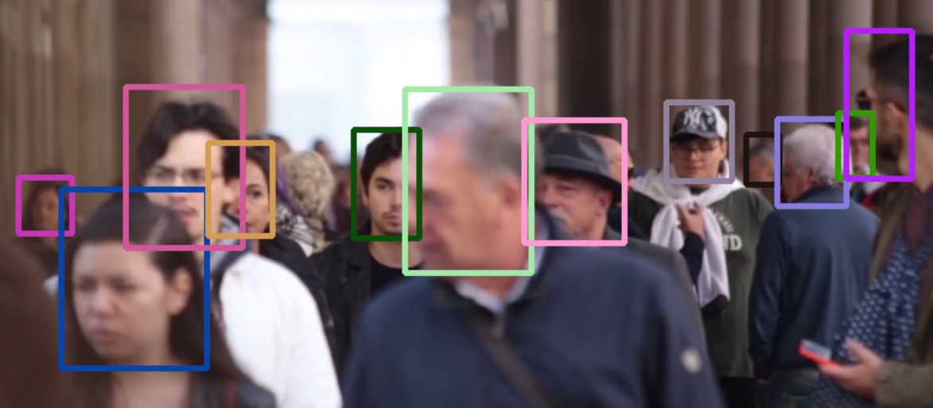
AUTOMATED FACE DETECTION USING
HAAR CASCADES AND TRACKING APIS
OBJECTIVE
Build an algorithm enabling the automated and semi-automated detection/tracking of faces on images and videos using the functionality of Haar cascades and various tracking APIs.
PREVIEW
© Copyright DOURTHE TECHNOLOGIES 2019

Slide 21
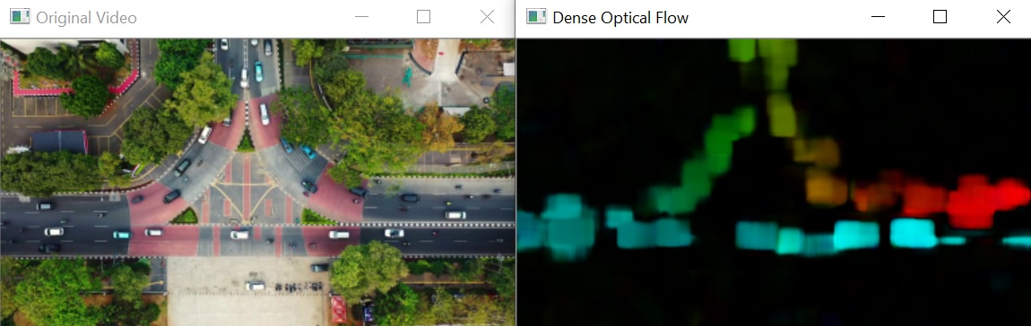
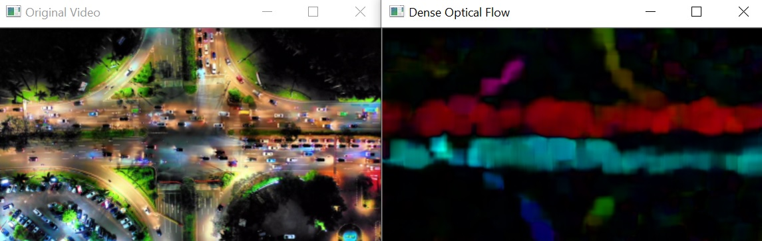
AUTOMATED MOTION DETECTION USING
DENSE OPTICAL FLOW MAPPING
OBJECTIVE
Build an algorithm enabling the automated detection of motion on loaded or live videos using Dense Optical Flow and the functionality of the Gunnar Farneback's algorithm.
PREVIEW
The algorithm allows to either load a video or run a live feed from your webcam and will open two windows to display to original video (or live feed) and the resulting dense optical flow mapping (color coded using HSV color mapping).
© Copyright DOURTHE TECHNOLOGIES 2019

Slide 22
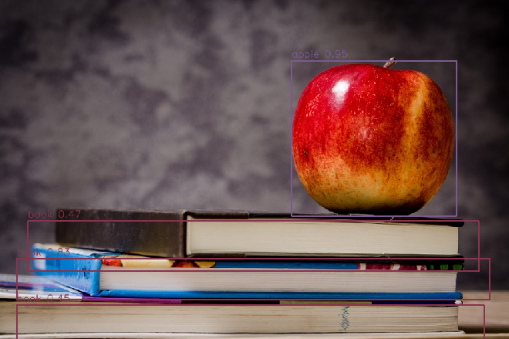
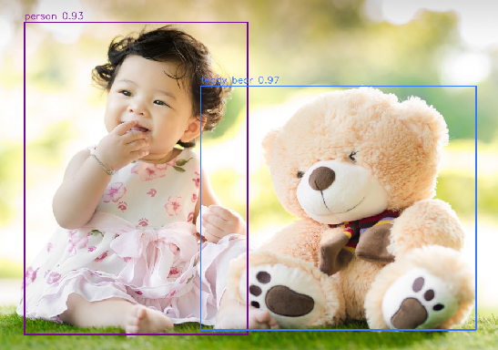
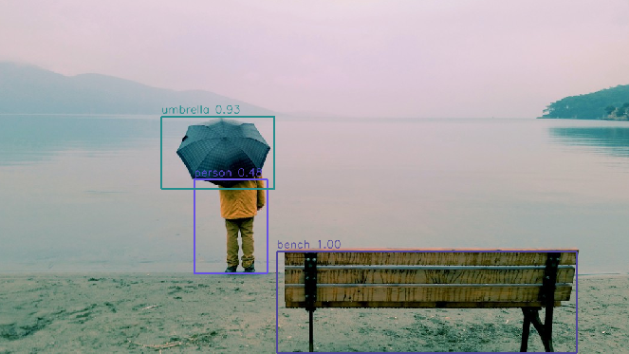
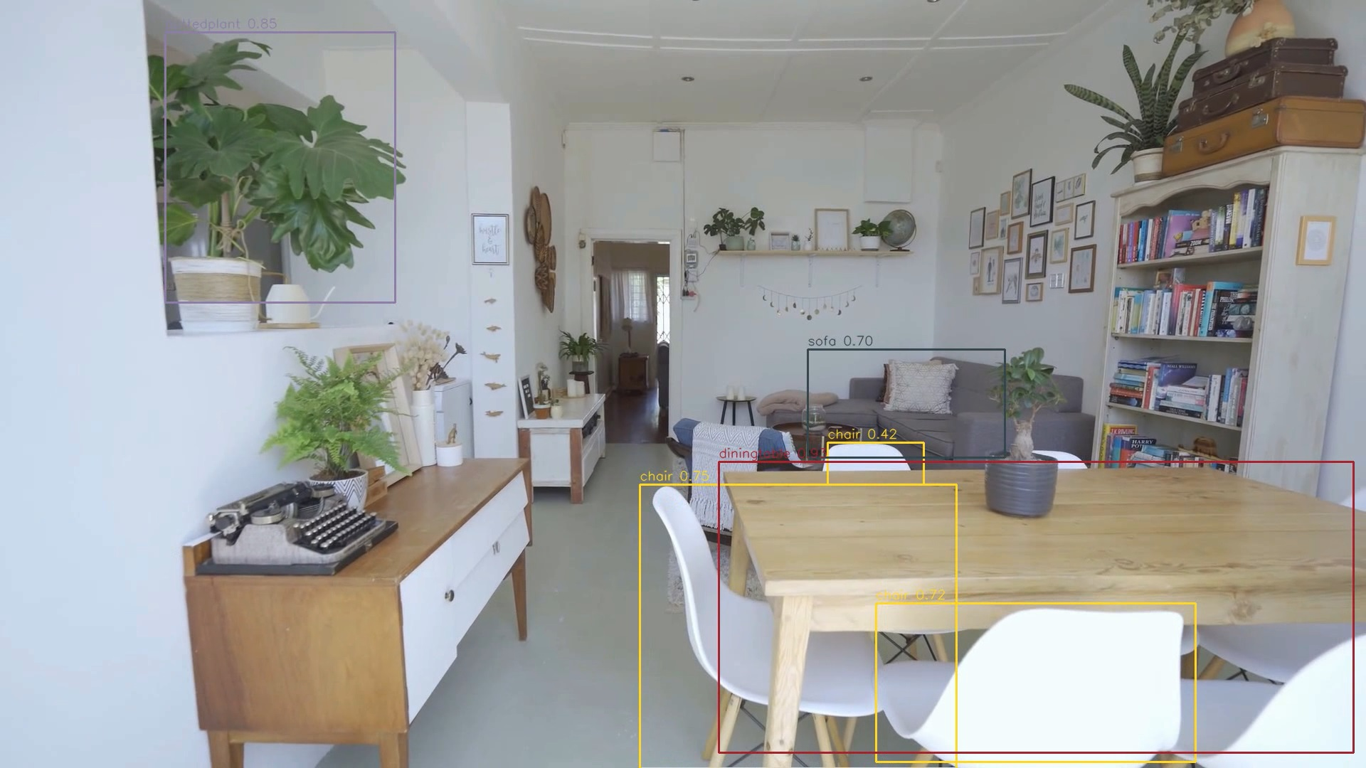
IMPLEMENTATION OF THE PRE-TRAINED YOLO MODEL FOR AUTOMATED OBJECT DETECTION
OBJECTIVE
Build an algorithm enabling the automated detection and tracking of objects on images and videos using the pre-trained weights of the deep learning YOLO (You Only Look Once) model.
PREVIEW
The algorithm results in images/videos where each identified object is contoured by a rectangle, around which the corresponding object label and probability is displayed.
© Copyright DOURTHE TECHNOLOGIES 2019

Slide 23
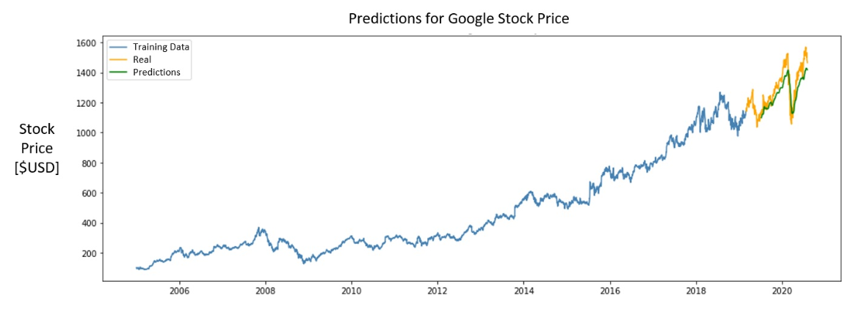
STOCK MARKET FORECASTING USING
DEEP RECURRENT NEURAL NETWORK
OBJECTIVE
Train a Deep Recurrent Neural Network (RNN) to predict next day Closing Price of a defined stock by using multivariate historical data and time series segmentation.
PREVIEW
© Copyright DOURTHE TECHNOLOGIES 2019

Slide 24
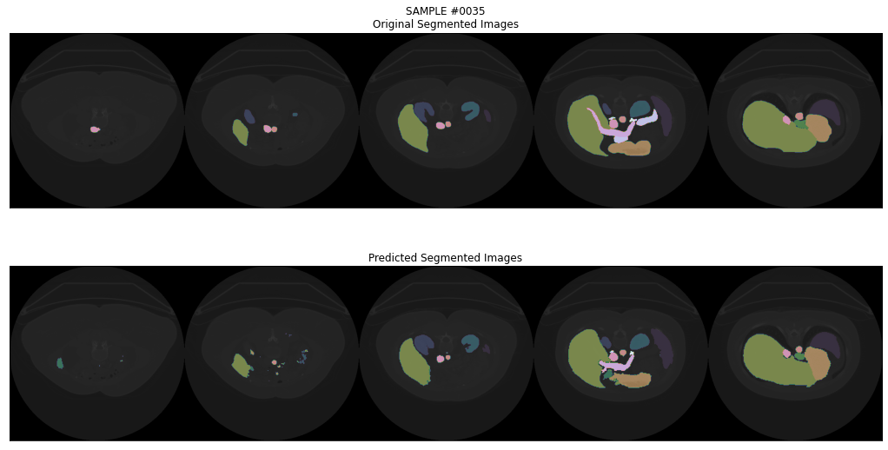
MULTI-ORGAN IMAGE SEGMENTATION USING MULTI-SCALE PYRAMID 3D FCN
OBJECTIVE
Implement a Multi-Scale Pyramid V-shaped 3D Fully Convolutional Network (FCN) architecture enabling the automated segmentation of multiple organs from CT image.
PREVIEW
REAL
PREDICTIONS
Slice A
Slice B
Slice C
Slice A
Slice B
Slice C
© Copyright DOURTHE TECHNOLOGIES 2020

Slide 25
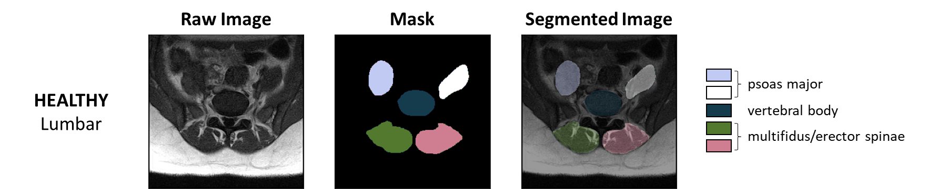
AUTOMATED SEGMENTATION OF SPINAL MUSCLES FROM UPRIGHT OPEN MRI
OBJECTIVE
Implement a Multi-Scale Pyramid 2D Convolutional Neural Network architecture enabling the automated segmentation of spinal muscles from Upright Open MR image.
PREVIEW
© Copyright DOURTHE TECHNOLOGIES 2022

Slide 26
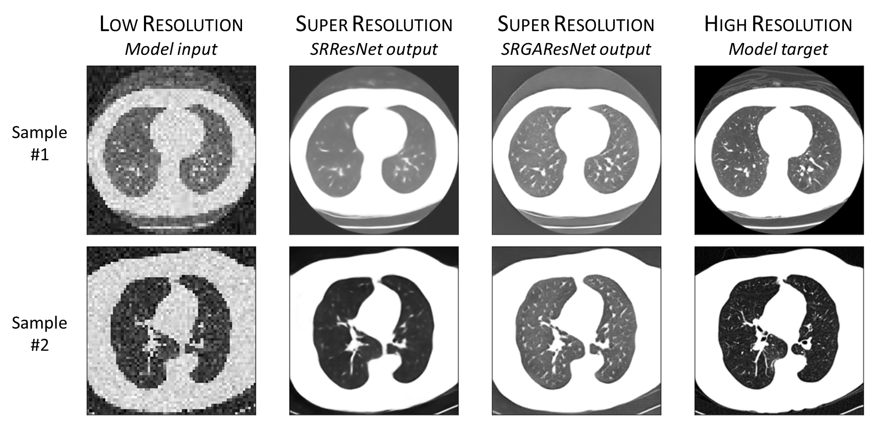
MEDICAL IMAGING RESOLUTION ENHANCEMENT USING SUPER RESOLUTION NEURAL NETWORK
OBJECTIVE
Implement a Super Resolution Neural Network (SRNN) to enhance the resolution of lung computed tomography (CT) images.
PREVIEW
© Copyright DOURTHE TECHNOLOGIES 2021

Slide 27
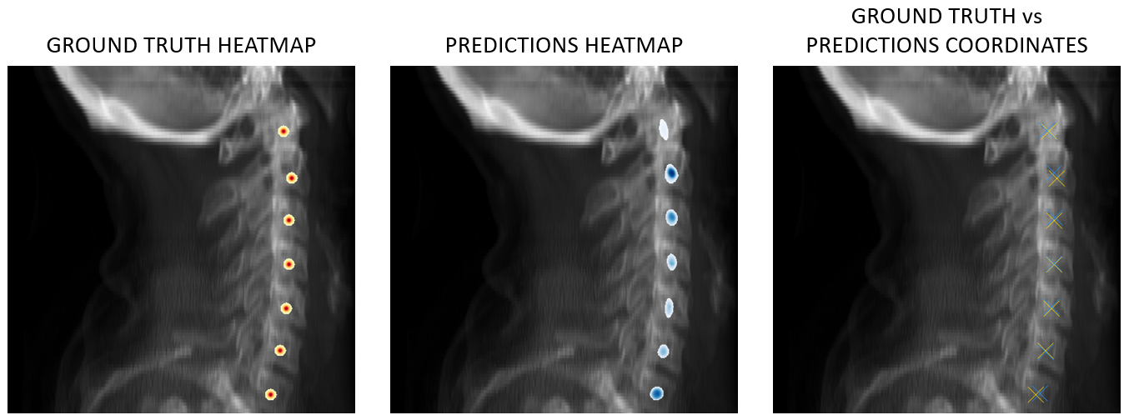
AUTOMATED LANDMARK DETECTION USING CONVOLUTIONAL NEURAL NETWORK
OBJECTIVE
To train a Neural Network to automatically detect the coordinates of anatomical landmarks from medical imaging data.
PREVIEW
© Copyright DOURTHE TECHNOLOGIES 2023

Slide 28
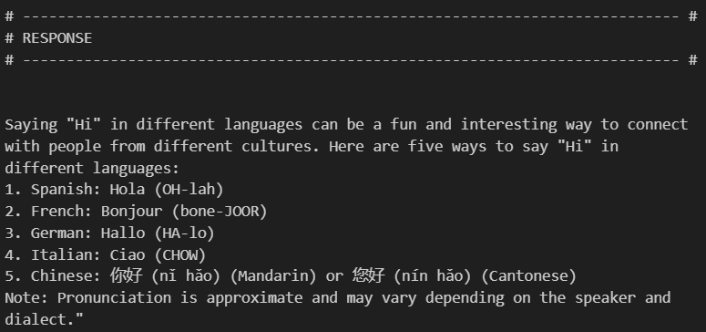
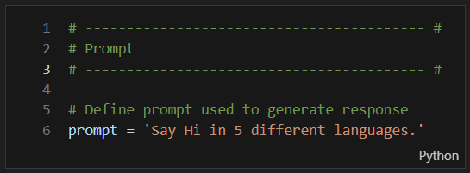
RUNNING THE LLAMA 2 LARGE LANGUAGE MODEL LOCALLY IN JUPYTER NOTEBOOK
OBJECTIVE
To harness the power of the Llama-2 large language model for text generation tasks from your local computer using Jupyter Notebook.
PREVIEW
© Copyright DOURTHE TECHNOLOGIES 2023

Slide 29
RUNNING THE LLAMA 2 LARGE LANGUAGE MODEL LOCALLY IN JUPYTER NOTEBOOK
OBJECTIVE
To harness the power of the Llama-2 large language model for text generation tasks from your local computer using Jupyter Notebook.
PREVIEW
© Copyright DOURTHE TECHNOLOGIES 2023

